Slide 1
Dealing With Stress
A Look at Stress Management for 2020 Teachers
Mindy Kissinger, MA, PhD Candidate

Slide 2
Stress and Teachers (before 2020)
Lesson Plans
Grading
Communicating with Students
Communicating with Parents
Maintaining Upbeat Energy to Promote Learning
Difficult Students
Working in a highly stimulating environment
Working within a time-line
Physically taxing job
Mentally taxing job
Work outside of class hours
Important job

Slide 3
Stress and Teachers (during 2020)
Mask wearing and enforcing
Extra cleaning
Remembering new rules and protocols
Switching between online and in-person formats
More lesson planning
Less control
New technology
More communication required
More creativity required
Higher risk job for infection
Pressure to stay healthy

Slide 4
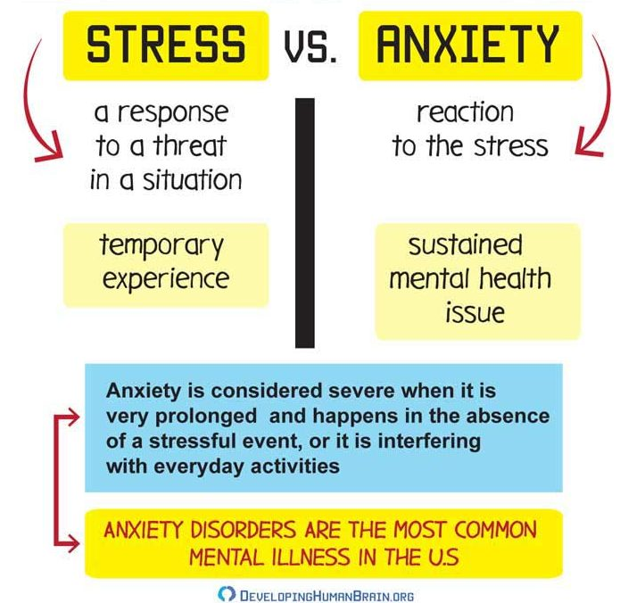

Slide 5
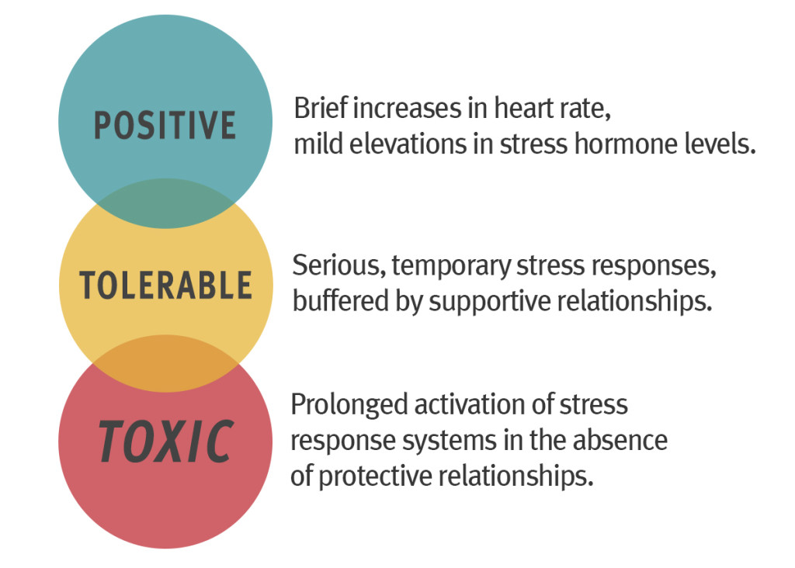

Slide 6
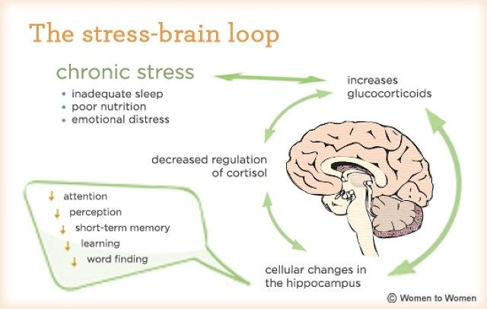

Slide 8
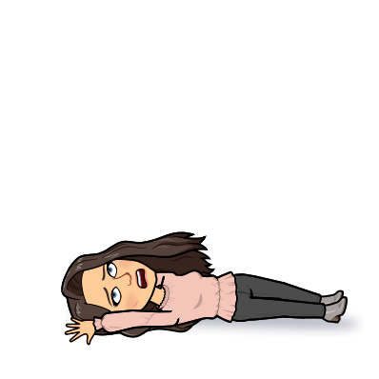

Slide 10
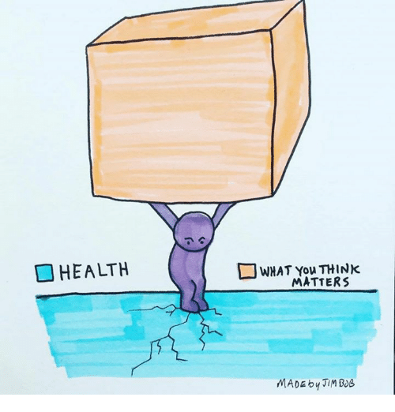

Slide 11
I forgot to do ________ today.
I can’t keep up.
My students aren’t engaged enough, is it my fault?
Are parents disappointed in me?
I am not as good of a teacher on Zoom.
Are my students learning enough?
I should have more energy.
What if I get sick?
This lesson did not go how I wanted.

Slide 12
That parent said their son loves coming to school. Let me sit in this feeling.
I am proud of myself for showing up.
Teaching is hard, thus I am brave.
This was the first time I tried that, what a great learning experience.
These students keep me young
"I know the Lord is always with me. I will not be shaken for he is right beside me.” Psalm 16:8
I am resourceful.
I get to try again tomorrow

Slide 13
Empty Chair Technique
What would you tell yourself?
What would you tell a loved one?

Slide 14
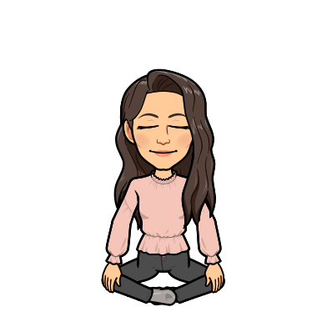
Stress Reduction Practices
Prayer/Meditation/Mindfulness
Flow
Shower Therapy
Music
Laughter
Expressions of Gratitude

Slide 15
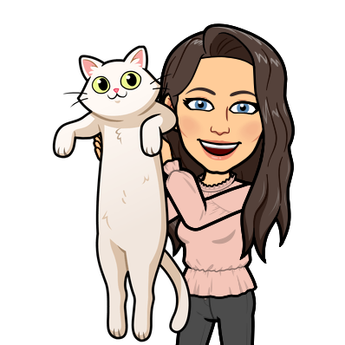
Stress Reduction Practices
Exercise
Journaling
Nature Walk
Pets
Get away from devices
Go to Therapy

Slide 16
Relaxation Apps
Abide Headspace Calm Relax Melodies

Slide 17
Mindfulness for Christian Teachers

Slide 18
I am doing a hard job during a difficult year. I may have days that feel long and simultaneously have not enough time to do all that I want to accomplish. That is okay. I will be graceful with myself and allow opportunity for growth instead of shame. Instead of comparing to previous years, I will remind myself that this year is not the same. I am a great teacher. I will continue to do great things for my students.

